Slide 1
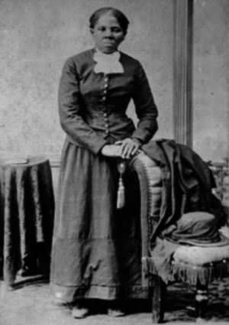
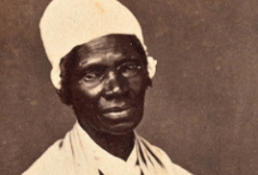
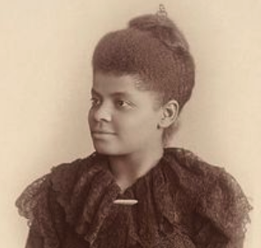
INTRODUCTION
Directions
Today we’re going to read an article about African American women who fought for equal voting rights in America.
Sojourner Truth
Ida B. Wells
Harriet Tubman

Slide 2
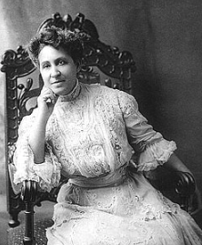
AGENDA
Complete Pre-reading Activity
Read “African American Suffragists” and answer the questions
Answer Exit Ticket Question
Mary Church Terrell
African-American Suffragist
Taught at M St. School in Washington D.C. (Now Paul Laurence Dunbar High School)

Slide 3
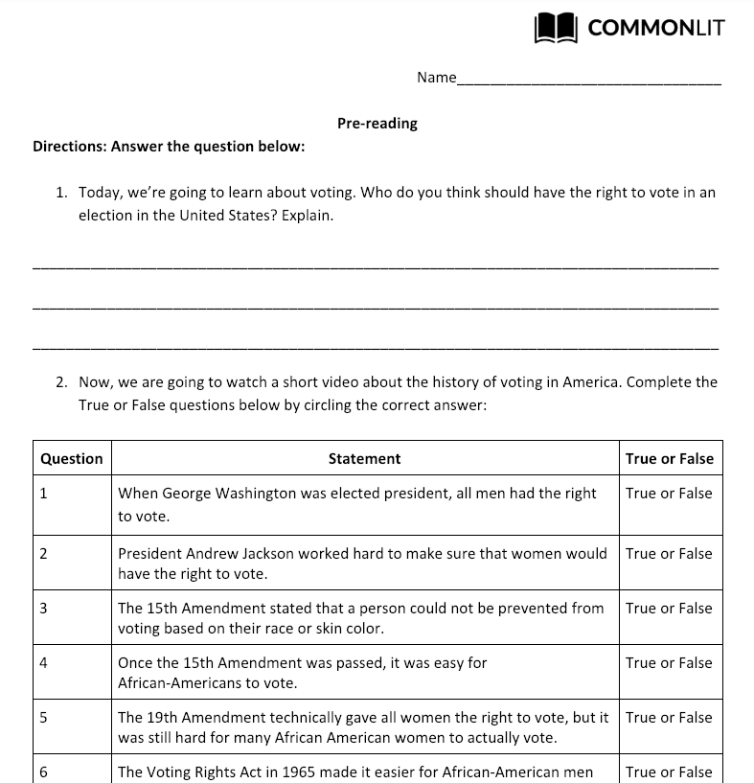
PRE-READING
Turn to page 1 in your CommonLit packet.
Answer Question 1

Slide 4
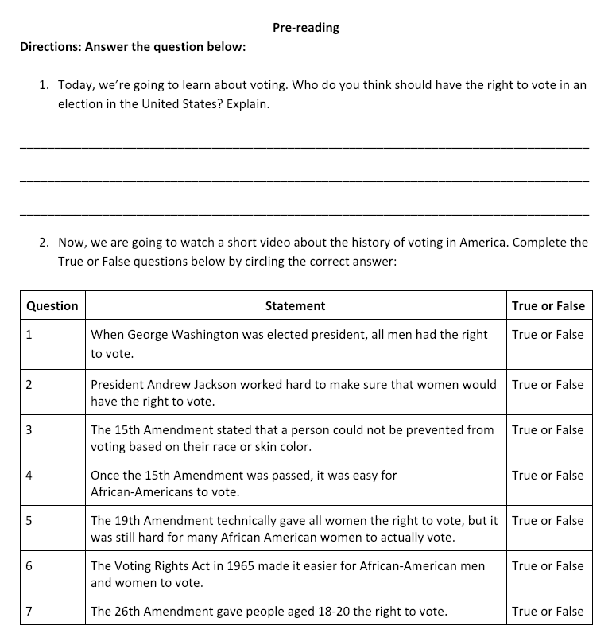
PRE-READING
Now we will watch a short video about the history of voting rights in the United States.
After we watch the video, circle “True” or “False” next to each statement.

Slide 5
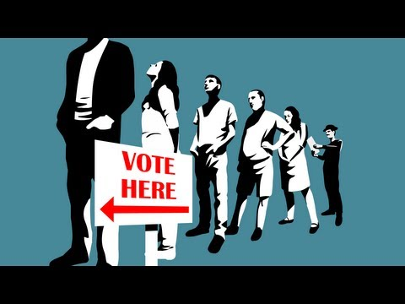
PRE-READING
Now we will watch a short video about the history of voting rights in the United States.
After we watch the video, circle “True” or “False” next to each statement.

Slide 6
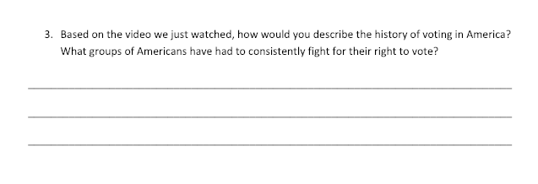
PRE-READING
Turn to Page 2
Answer Question 3

Slide 7
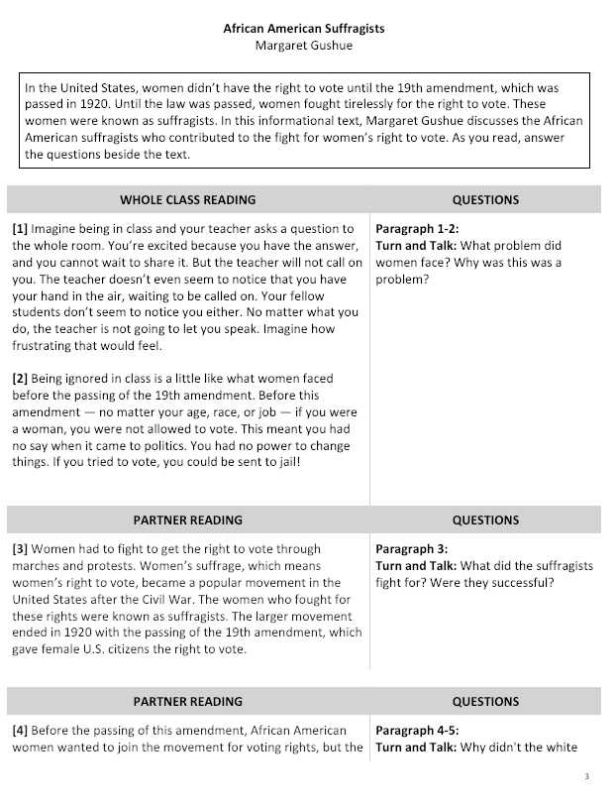
Directions
Turn to page 3 in your CommonLit packet.
Follow along as we read the article.
We’ll pause to answer the questions.
Page 3

Slide 8
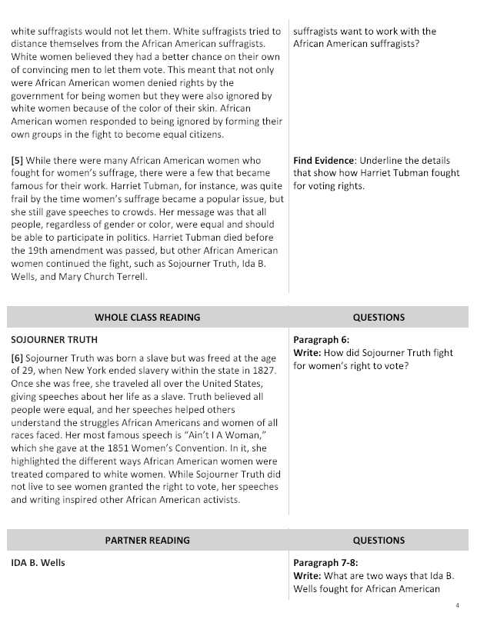
Directions
Page 4

Slide 9
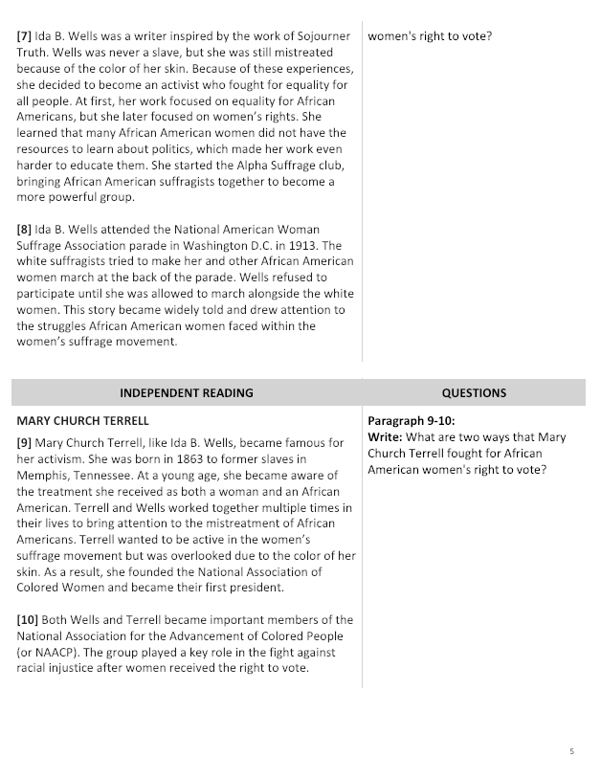
Directions
Page 5

Slide 10
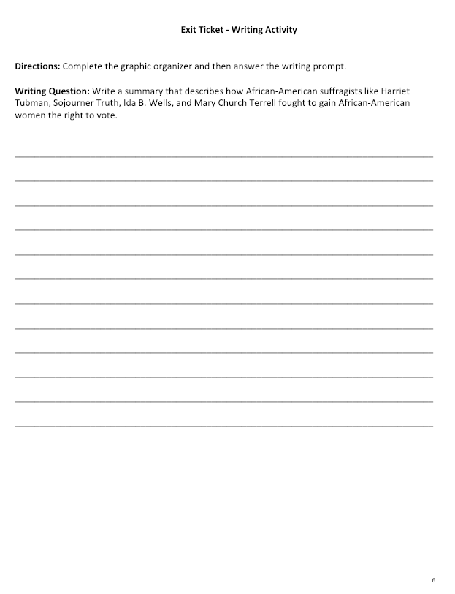
EXIT TICKET
Directions
Turn to page 6 in your CommonLit packet.
Complete the Exit Ticket.
Use the text to help complete your paragraph.

