Slide 1
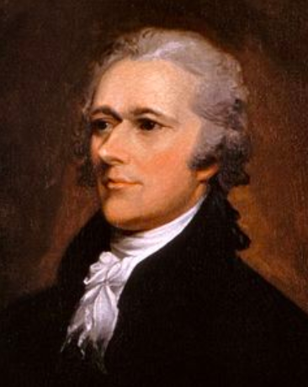
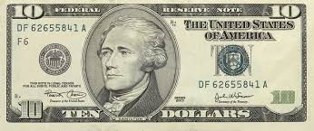
INTRODUCTION
Directions
Today we’re going to read an article from CommonLit about Alexander Hamilton to help us prepare for our upcoming class trip.

Slide 2
AGENDA
Complete Pre-reading Activity
Read “Alexander Hamilton” and answer the questions
Answer Exit Ticket Question

Slide 3
PRE-READING
Turn to page 1 in your CommonLit packet.
We will watch a short video about the life of Alexander Hamilton.
After we watch the video, circle “True” or “False” next to each statement.

Slide 4
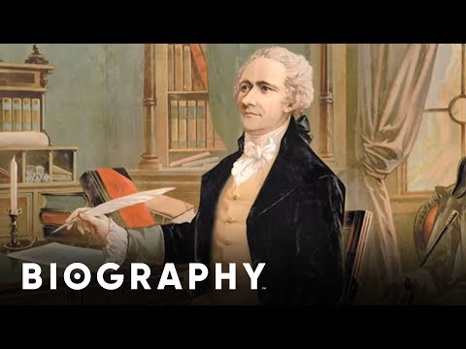
PRE-READING
Turn to page 1 in your CommonLit packet.
We will watch a short video about the life of Alexander Hamilton.
After we watch the video, circle “True” or “False” next to each statement.

Slide 5
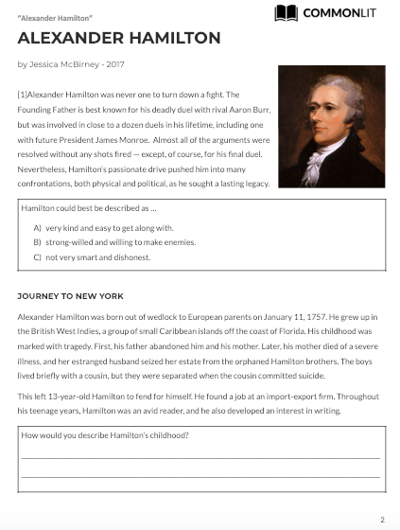
Directions
Turn to page 2 in your CommonLit packet.
Follow along as we read the article.
We’ll pause to answer the questions.
Page 2

Slide 6
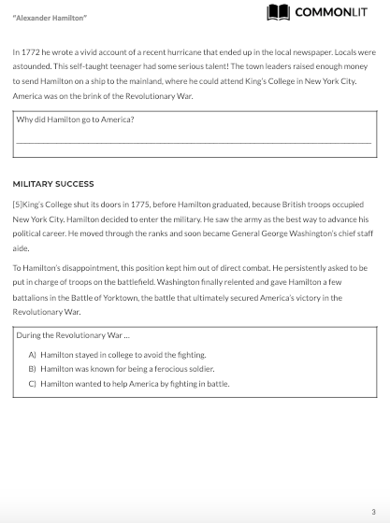
Directions
Page 3

Slide 7
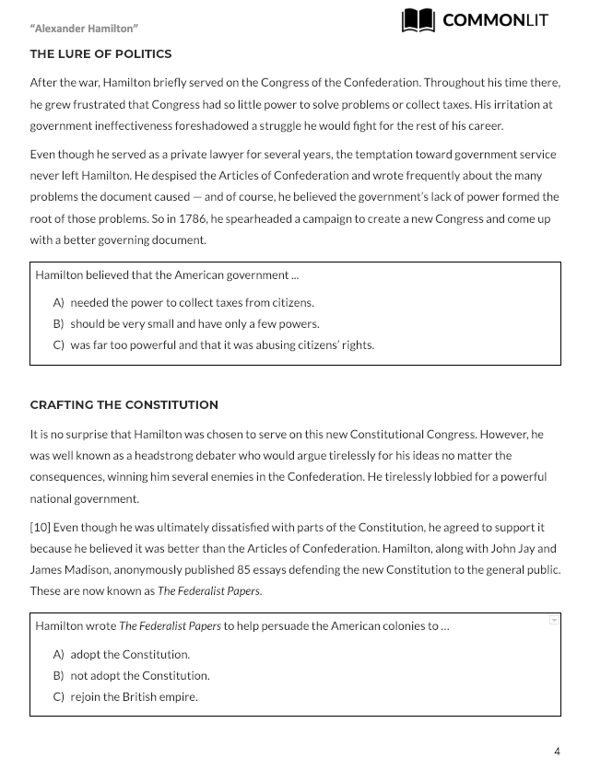
Directions
Page 4

Slide 8
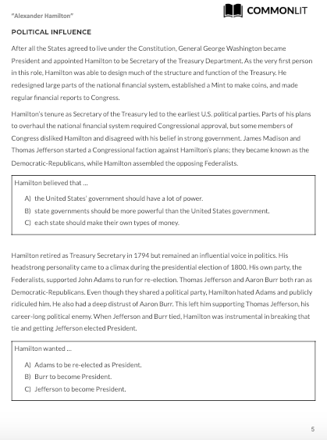
Directions
Page 5

Slide 9
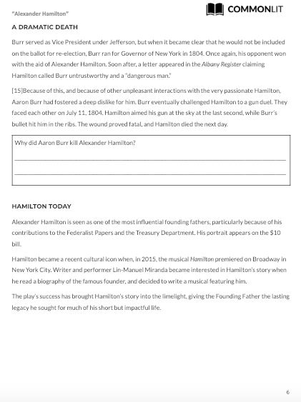
Directions
Page 6

Slide 10
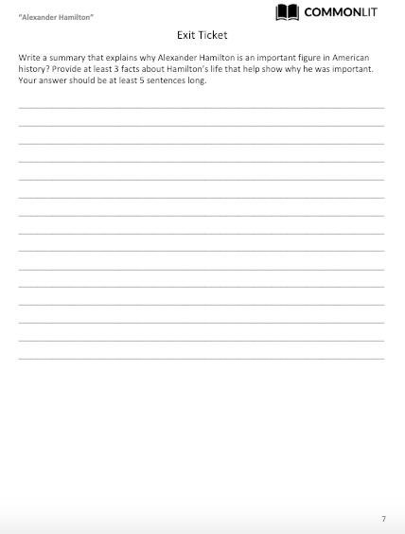
EXIT TICKET
Directions
Turn to page 7 in your CommonLit packet.
Complete the Exit Ticket.
Use the text to help complete your paragraph.

